Slide 1
Ensemble Methods

Slide 2
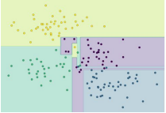
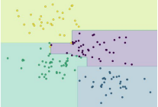
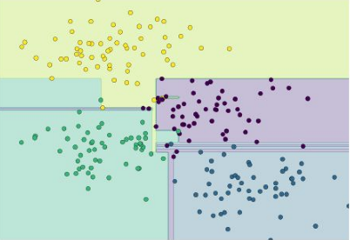
Ensemble Methods -
Train multiple weak predictors on a dataset such that they get slightly different results some learn some patterns better and others learn other patterns
Combine their predictions to get an overall better performance
The combined group of learners is call meta model
Meta models
Trained on slightly differ data
Combined result with better accuracy than individual models
Source: Python Data Science Handbook / Page 424

Slide 3
Ensemble Methods -
In some parts of the feature space, the different instances produce similar results for e.g. in the extreme regions
In regions where the data points from different classes overlap, the instances give different results
Thus by using information from all the instances, may give overall better result than individual instances

Slide 4
Ensemble Methods -
To ensure each learner gets to see slightly different data can be done in many ways
Random sampling with replacement (Bootstrapping / sampling with replacement)
By adjusting the weights assigned to each data point to force an instance to focus on certain data points more
Only Random Forest ensemble technique is designed only for decision Tree
For other ensemble methods, each instance in the meta model can be build out of different algorithm. For instance DecisionTree, Naïve Bayes, Support Vector Machine.

Slide 5
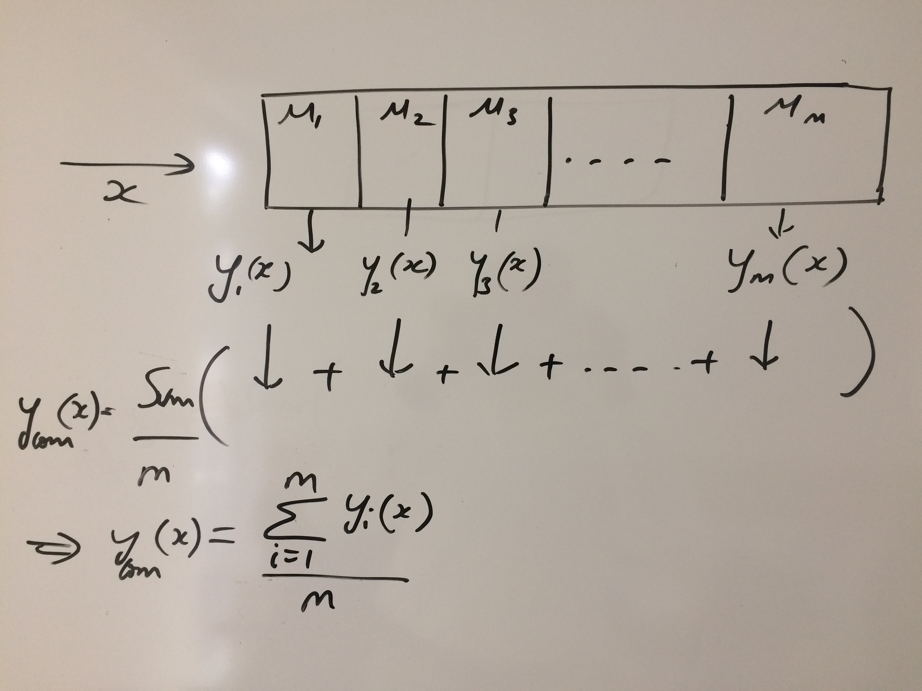

Slide 6
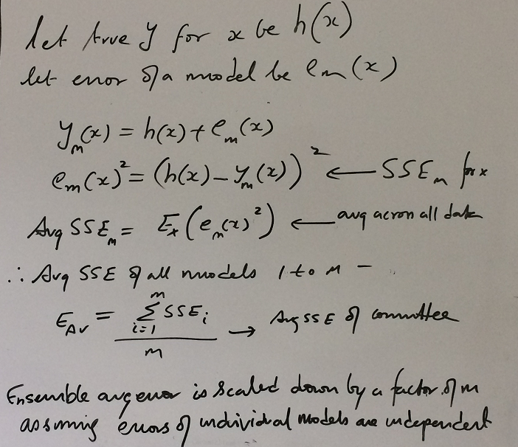

Slide 7
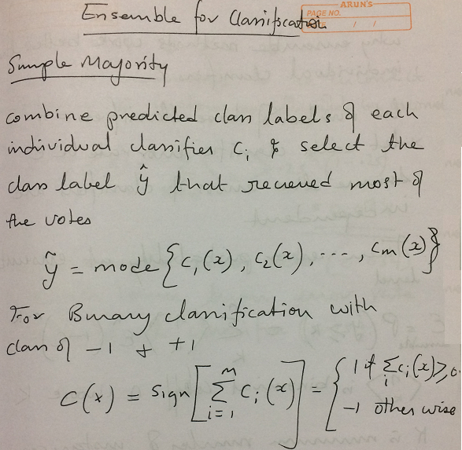

Slide 9
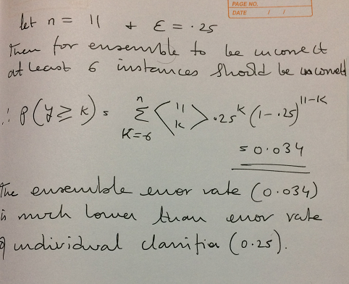

Slide 10
Prerequisites for effective ensemble:
The performance of an ensemble mostly depends on the individual performance of the classifiers present in the ensemble.
Two key requirements of the classifiers forming the ensemble are:
diversity of classifiers in nature - Similar classifiers usually make similar errors, so forming an ensemble with similar classifiers would not improve the classification rate
accuracy in the classifier predictions - presence of a poorly performing classifier may cause performance deterioration in the overall performance.

Slide 11
Two families of ensemble methods are usually distinguished:
Averaging methods, the driving principle is to build several estimators independently and then to average / vote their predictions. On average, the combined estimator is usually better than any of the single base estimator because its variance is reduced.
E.g. Bagging methods, Forests of randomized trees, ...
Boosting methods, base estimators are built sequentially and one tries to reduce the bias of the combined estimator. The motivation is to combine several weak models to produce a powerful ensemble. E.g. AdaBoost, Gradient Tree Boosting, ...

Slide 12
Ensemble Methods – Averaging method - Bagging (Bootstrap Aggregation) :
Designed to improve the stability (small change in dataset change the model) and accuracy of classification and regression models
It reduces variance errors and helps to avoid overfitting
Can be used with any type of machine learning model, mostly used with Decision Tree
Uses sampling with replacement to generate multiple samples of a given size. Sample may contain repeat data points
For large sample size, sample data is expected to have roughly 63.2% ( 1 – 1/e) unique data points and the rest being duplicates
For classification bagging is used with voting to decide the class of an input while for regression average or median values are calculate
Notes:
Bagging methods come in different flavours but mostly differ by the way they draw random subsets of the training set
When random subsets of the data set are drawn as random subsets of the samples, the algorithm is known as pasting
When samples are drawn with replacement, the method is known as Bagging (Bootstrap Aggregation)
When the random subsets of the dataset are drawn as random subsets of the features, then the method is known as random subspaces
When the base estimators are built on subsets of both samples and features, the method is called random patches
Source: Scikit-learn user guide, chapter 3, page 230
Expected number of data points in a bootstrap sample N. (1-(1-1/n)^n)
As N -> large number (1-(1 – 1/n)^n ) -> ( 1- 1/e) = 63.2

Slide 13
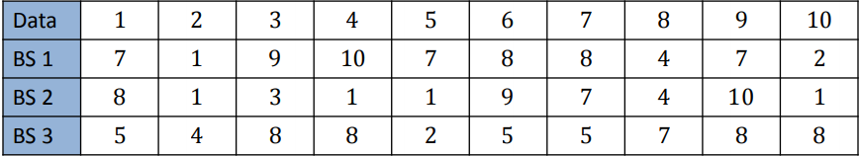
Ensemble Methods – Averaging method - Bagging (Bootstrap Aggregation) :
Multiple sample sets are created from the same data set using random function
Each sample data set is used to create a predictor
Source: http://www.utdallas.edu/~nrr150130/cs7301/2016fa/lects/Lecture_10_Ensemble.pdf

Slide 14
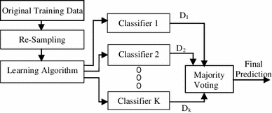
Ensemble Methods – Averaging method - Bagging (Bootstrap Aggregation) :
Re-sampling done for every classifier using a random function. For large n, 63.2% unique samples likely to be selected
Voting could be simple or weighted
Algorithm to generate classifiers. Could be Decision Tree, Naïve Bayes etc
K classifiers created in parallel and independently on respective training data
Source: https://link.springer.com/article/10.1007/s13721-013-0034-x

Slide 15
Ensemble Learning – Bagging:
Lab- 6 Improve defaulter prediction of the decision tree using bagging ensemble technique
Description – Sample data is available at local file system as credit.csv
The dataset has 16 attributes described at https://archive.ics.uci.edu/ml/datasets/statlog+(german+credit+data)
or in the notes page of this slide
Sol: Bagging+Credit+Decision+Tree.ipynb
Notes:
Attribute 1: (qualitative) Status of existing checking account A11 : ... < 0 DM A12 : 0 <= ... < 200 DM A13 : ... >= 200 DM / salary assignments for at least 1 year A14 : no checking account Attribute 2: (numerical) Duration in month Attribute 3: (qualitative) Credit history A30 : no credits taken/ all credits paid back duly A31 : all credits at this bank paid back duly A32 : existing credits paid back duly till now A33 : delay in paying off in the past A34 : critical account/ other credits existing (not at this bank) Attribute 4: (qualitative) Purpose A40 : car (new) A41 : car (used) A42 : furniture/equipment A43 : radio/television A44 : domestic appliances A45 : repairs A46 : education A47 : (vacation - does not exist?) A48 : retraining A49 : business A410 : others Attribute 5: (numerical) Credit amount Attibute 6: (qualitative) Savings account/bonds A61 : ... < 100 DM A62 : 100 <= ... < 500 DM A63 : 500 <= ... < 1000 DM A64 : .. >= 1000 DM A65 : unknown/ no savings account Attribute 7: (qualitative) Present employment since A71 : unemployed A72 : ... < 1 year A73 : 1 <= ... < 4 years A74 : 4 <= ... < 7 years A75 : .. >= 7 years Attribute 8: (numerical) Installment rate in percentage of disposable income Attribute 9: (qualitative) Personal status and sex A91 : male : divorced/separated A92 : female : divorced/separated/married A93 : male : single A94 : male : married/widowed A95 : female : single Attribute 10: (qualitative) Other debtors / guarantors A101 : none A102 : co-applicant A103 : guarantor Attribute 11: (numerical) Present residence since Attribute 12: (qualitative) Property A121 : real estate A122 : if not A121 : building society savings agreement/ life insurance A123 : if not A121/A122 : car or other, not in attribute 6 A124 : unknown / no property Attribute 13: (numerical) Age in years Attribute 14: (qualitative) Other installment plans A141 : bank A142 : stores A143 : none Attribute 15: (qualitative) Housing A151 : rent A152 : own A153 : for free Attribute 16: (numerical) Number of existing credits at this bank Attribute 17: (qualitative) Job A171 : unemployed/ unskilled - non-resident A172 : unskilled - resident A173 : skilled employee / official A174 : management/ self-employed/ highly qualified employee/ officer Attribute 18: (numerical) Number of people being liable to provide maintenance for Attribute 19: (qualitative) Telephone A191 : none A192 : yes, registered under the customers name Attribute 20: (qualitative) foreign worker A201 : yes A202 : no

Slide 16
Ensemble Methods – Boosting Method – AdaBoosting :
Similar to bagging, but the learners are grown sequentially; except for the first, each subsequent learner is grown from previously grown learners
If the learner is a Decision Tree, each of the trees can be small, with just a few terminal nodes (determined by the parameter d supplied )
During voting higher weight is given to the votes of learners which perform better in respective training data unlike Bagging where all get equal weight
Boosting slows down learning (because it is sequential) but the model generally performs well

Slide 17
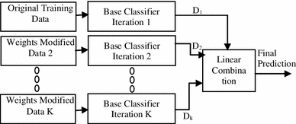
Ensemble Methods – Boosting method - AdaBoosting:
Training data from base data with focus on instances which were incorrectly classified by earlier model (if any)
Voting could be simple or weighted
K similar classifiers created in sequence with respective training data with focus on addressing the misclassified data, not the usual cost functions
It is called Adaptive Boosting as the weights are re-assigned to each instance, with higher weights to incorrectly classified instance
Source: https://link.springer.com/article/10.1007/s13721-013-0034-x

Slide 18
Ensemble Methods – Boosting Method – AdaBoosting :
Two prominent boosting algorithms are AdaBoost, short for Adaptive Boosting and Gradient Descent Boosting
In AdaBoost, the successive learners are created with a focus on the ill fitted data of the previous learner
Each successive learner focuses more and more on the harder to fit data i.e. their residuals in the previous tree

Slide 19
Ensemble Learning – AdaBoosting:
Lab- 7 Improve defaulter prediction of the decision tree using Adaboosting
Description – Sample data is available at local file system as credit.csv
The dataset has 16 attributes described at https://archive.ics.uci.edu/ml/datasets/statlog+(german+credit+data)
or in the notes page of this slide
Sol: Adaboost+Credit+Decision+Tree.ipynb
Notes:
Attribute 1: (qualitative) Status of existing checking account A11 : ... < 0 DM A12 : 0 <= ... < 200 DM A13 : ... >= 200 DM / salary assignments for at least 1 year A14 : no checking account Attribute 2: (numerical) Duration in month Attribute 3: (qualitative) Credit history A30 : no credits taken/ all credits paid back duly A31 : all credits at this bank paid back duly A32 : existing credits paid back duly till now A33 : delay in paying off in the past A34 : critical account/ other credits existing (not at this bank) Attribute 4: (qualitative) Purpose A40 : car (new) A41 : car (used) A42 : furniture/equipment A43 : radio/television A44 : domestic appliances A45 : repairs A46 : education A47 : (vacation - does not exist?) A48 : retraining A49 : business A410 : others Attribute 5: (numerical) Credit amount Attibute 6: (qualitative) Savings account/bonds A61 : ... < 100 DM A62 : 100 <= ... < 500 DM A63 : 500 <= ... < 1000 DM A64 : .. >= 1000 DM A65 : unknown/ no savings account Attribute 7: (qualitative) Present employment since A71 : unemployed A72 : ... < 1 year A73 : 1 <= ... < 4 years A74 : 4 <= ... < 7 years A75 : .. >= 7 years Attribute 8: (numerical) Installment rate in percentage of disposable income Attribute 9: (qualitative) Personal status and sex A91 : male : divorced/separated A92 : female : divorced/separated/married A93 : male : single A94 : male : married/widowed A95 : female : single Attribute 10: (qualitative) Other debtors / guarantors A101 : none A102 : co-applicant A103 : guarantor Attribute 11: (numerical) Present residence since Attribute 12: (qualitative) Property A121 : real estate A122 : if not A121 : building society savings agreement/ life insurance A123 : if not A121/A122 : car or other, not in attribute 6 A124 : unknown / no property Attribute 13: (numerical) Age in years Attribute 14: (qualitative) Other installment plans A141 : bank A142 : stores A143 : none Attribute 15: (qualitative) Housing A151 : rent A152 : own A153 : for free Attribute 16: (numerical) Number of existing credits at this bank Attribute 17: (qualitative) Job A171 : unemployed/ unskilled - non-resident A172 : unskilled - resident A173 : skilled employee / official A174 : management/ self-employed/ highly qualified employee/ officer Attribute 18: (numerical) Number of people being liable to provide maintenance for Attribute 19: (qualitative) Telephone A191 : none A192 : yes, registered under the customers name Attribute 20: (qualitative) foreign worker A201 : yes A202 : no

Slide 20
Ensemble Methods – Averaging Method – Gradient Descent Boosting :
Each learner is fit on a modified version of original data (original data is replaced with the x values and residuals from previous learner
By fitting new models to the residuals, the overall learner gradually improves in areas where residuals are initially high

Slide 21
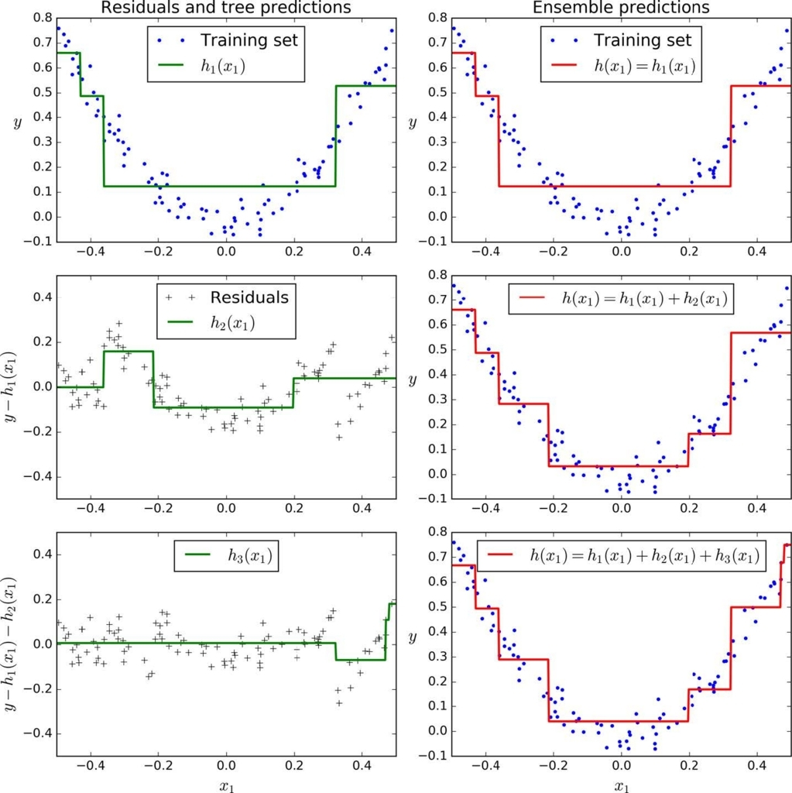
Ensemble Methods – Averaging Method – Gradient Descent Boosting :
First learner results in residuals (dots that fall above and below the surface. The result (red) is same as first classifier
Next classifier focuses on the residuals of the first classifier to reclassify them as correctly as possible
The combined effect of this surface and previous classifier surface is shown in red
The third learner focusses on the residuals of the previous classifier
The combine result of the new surface with the previous surface is shown in red

Slide 22
Ensemble Learning – Gradient Boosting:
Lab- 8 Improve defaulter prediction of the decision tree using Gradient boosting
Description – Sample data is available at local file system as credit.csv
The dataset has 16 attributes described at https://archive.ics.uci.edu/ml/datasets/statlog+(german+credit+data)
or in the notes page of this slide
Sol: GRB+Credit+Decision+Tree.ipynb
Notes:
Attribute 1: (qualitative) Status of existing checking account A11 : ... < 0 DM A12 : 0 <= ... < 200 DM A13 : ... >= 200 DM / salary assignments for at least 1 year A14 : no checking account Attribute 2: (numerical) Duration in month Attribute 3: (qualitative) Credit history A30 : no credits taken/ all credits paid back duly A31 : all credits at this bank paid back duly A32 : existing credits paid back duly till now A33 : delay in paying off in the past A34 : critical account/ other credits existing (not at this bank) Attribute 4: (qualitative) Purpose A40 : car (new) A41 : car (used) A42 : furniture/equipment A43 : radio/television A44 : domestic appliances A45 : repairs A46 : education A47 : (vacation - does not exist?) A48 : retraining A49 : business A410 : others Attribute 5: (numerical) Credit amount Attibute 6: (qualitative) Savings account/bonds A61 : ... < 100 DM A62 : 100 <= ... < 500 DM A63 : 500 <= ... < 1000 DM A64 : .. >= 1000 DM A65 : unknown/ no savings account Attribute 7: (qualitative) Present employment since A71 : unemployed A72 : ... < 1 year A73 : 1 <= ... < 4 years A74 : 4 <= ... < 7 years A75 : .. >= 7 years Attribute 8: (numerical) Installment rate in percentage of disposable income Attribute 9: (qualitative) Personal status and sex A91 : male : divorced/separated A92 : female : divorced/separated/married A93 : male : single A94 : male : married/widowed A95 : female : single Attribute 10: (qualitative) Other debtors / guarantors A101 : none A102 : co-applicant A103 : guarantor Attribute 11: (numerical) Present residence since Attribute 12: (qualitative) Property A121 : real estate A122 : if not A121 : building society savings agreement/ life insurance A123 : if not A121/A122 : car or other, not in attribute 6 A124 : unknown / no property Attribute 13: (numerical) Age in years Attribute 14: (qualitative) Other installment plans A141 : bank A142 : stores A143 : none Attribute 15: (qualitative) Housing A151 : rent A152 : own A153 : for free Attribute 16: (numerical) Number of existing credits at this bank Attribute 17: (qualitative) Job A171 : unemployed/ unskilled - non-resident A172 : unskilled - resident A173 : skilled employee / official A174 : management/ self-employed/ highly qualified employee/ officer Attribute 18: (numerical) Number of people being liable to provide maintenance for Attribute 19: (qualitative) Telephone A191 : none A192 : yes, registered under the customers name Attribute 20: (qualitative) foreign worker A201 : yes A202 : no

Slide 23
Ensemble Methods – Random Forest:
Each tree in the ensemble is built from a sample drawn with replacement (bootstrap) from the training set
In addition, when splitting a node during the construction of a tree, the split that is chosen is no longer the best split among all the features
Instead, the split is picked is the best split among a random subset of the features
As a result of this randomness, the bias of the forest usually slightly increases (with respect to the bias of a single non-random tree)
Due to averaging, its variance decreases, usually more than compensating the increase in bias, hence yielding overall a better result
Source: scikit-learn user guide , chapter 3 , page 231

Slide 24

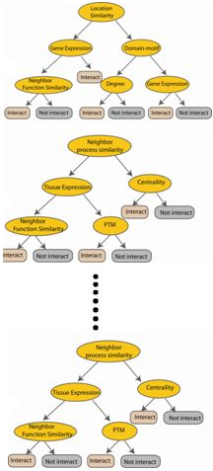



Ensemble Methods - Random Forest:
Used with Decision Trees. Create different trees by providing different sub-features from the feature set to the tree creating algorithm. The optimization function is Entropy or Gini index
Randomly selected sub feature set
Independent trees created in parallel
N instances
Original number of features

Slide 25
Ensemble Learning – Random Forest:
Lab- 9 Improve defaulter prediction of the decision tree using Random Forest
Description – Sample data is available at local file system as credit.csv
The dataset has 16 attributes described at https://archive.ics.uci.edu/ml/datasets/statlog+(german+credit+data)
or in the notes page of this slide
Sol: RF+Credit+Decision+Tree.ipynb
Notes:
Attribute 1: (qualitative) Status of existing checking account A11 : ... < 0 DM A12 : 0 <= ... < 200 DM A13 : ... >= 200 DM / salary assignments for at least 1 year A14 : no checking account Attribute 2: (numerical) Duration in month Attribute 3: (qualitative) Credit history A30 : no credits taken/ all credits paid back duly A31 : all credits at this bank paid back duly A32 : existing credits paid back duly till now A33 : delay in paying off in the past A34 : critical account/ other credits existing (not at this bank) Attribute 4: (qualitative) Purpose A40 : car (new) A41 : car (used) A42 : furniture/equipment A43 : radio/television A44 : domestic appliances A45 : repairs A46 : education A47 : (vacation - does not exist?) A48 : retraining A49 : business A410 : others Attribute 5: (numerical) Credit amount Attibute 6: (qualitative) Savings account/bonds A61 : ... < 100 DM A62 : 100 <= ... < 500 DM A63 : 500 <= ... < 1000 DM A64 : .. >= 1000 DM A65 : unknown/ no savings account Attribute 7: (qualitative) Present employment since A71 : unemployed A72 : ... < 1 year A73 : 1 <= ... < 4 years A74 : 4 <= ... < 7 years A75 : .. >= 7 years Attribute 8: (numerical) Installment rate in percentage of disposable income Attribute 9: (qualitative) Personal status and sex A91 : male : divorced/separated A92 : female : divorced/separated/married A93 : male : single A94 : male : married/widowed A95 : female : single Attribute 10: (qualitative) Other debtors / guarantors A101 : none A102 : co-applicant A103 : guarantor Attribute 11: (numerical) Present residence since Attribute 12: (qualitative) Property A121 : real estate A122 : if not A121 : building society savings agreement/ life insurance A123 : if not A121/A122 : car or other, not in attribute 6 A124 : unknown / no property Attribute 13: (numerical) Age in years Attribute 14: (qualitative) Other installment plans A141 : bank A142 : stores A143 : none Attribute 15: (qualitative) Housing A151 : rent A152 : own A153 : for free Attribute 16: (numerical) Number of existing credits at this bank Attribute 17: (qualitative) Job A171 : unemployed/ unskilled - non-resident A172 : unskilled - resident A173 : skilled employee / official A174 : management/ self-employed/ highly qualified employee/ officer Attribute 18: (numerical) Number of people being liable to provide maintenance for Attribute 19: (qualitative) Telephone A191 : none A192 : yes, registered under the customers name Attribute 20: (qualitative) foreign worker A201 : yes A202 : no

Slide 26
Ensemble Methods – Stacking:
Similar to bagging, but apply several different models to original data
The weights for each model is determined based on how well they perform on the given input data
Similar classifiers usually make similar errors (bagging), so forming an ensemble with similar classifiers may not improve the classification rate
Presence of a poorly performing classifier may cause performance deterioration in the overall performance
Similarly, even on presence of a classifier that performs much better than all of the other available base classifiers, may cause degradation in the overall performance
Another important factor is the amount of correlation among the incorrect classifications made by each classifier
If the consistent classifiers tend to misclassify the same instances, then combining their results will have no benefit
In contrast, a greater amount of independence among the classifiers can result in errors by individual classifiers being overlooked when the results of the ensemble are combined.

Slide 27
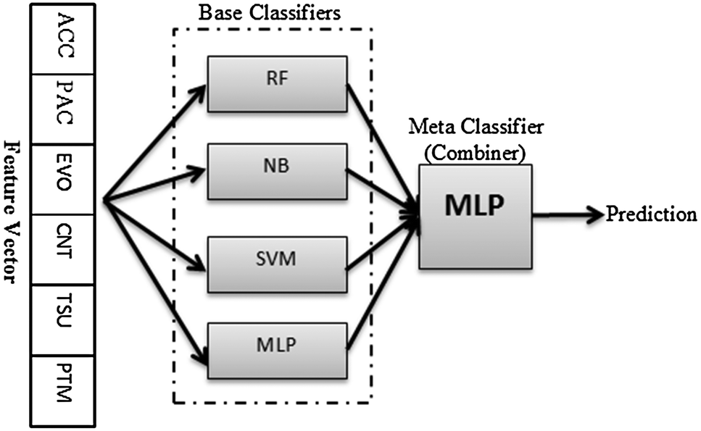
Ensemble Methods – Stacking:
Source: http://pubs.rsc.org/-/content/articlelanding/2014/mb/c4mb00410h/unauth#!divAbstract

Slide 28
Ensemble Learning – Stacking:
Lab- 10 Improve defaulter prediction of the decision tree using Stacking
Description – Sample data is available at local file system as credit.csv
The dataset has 16 attributes described at https://archive.ics.uci.edu/ml/datasets/statlog+(german+credit+data)
or in the notes page of this slide
Sol: Stacking+Credit+Decision+Tree.ipynb
Notes:
Attribute 1: (qualitative) Status of existing checking account A11 : ... < 0 DM A12 : 0 <= ... < 200 DM A13 : ... >= 200 DM / salary assignments for at least 1 year A14 : no checking account Attribute 2: (numerical) Duration in month Attribute 3: (qualitative) Credit history A30 : no credits taken/ all credits paid back duly A31 : all credits at this bank paid back duly A32 : existing credits paid back duly till now A33 : delay in paying off in the past A34 : critical account/ other credits existing (not at this bank) Attribute 4: (qualitative) Purpose A40 : car (new) A41 : car (used) A42 : furniture/equipment A43 : radio/television A44 : domestic appliances A45 : repairs A46 : education A47 : (vacation - does not exist?) A48 : retraining A49 : business A410 : others Attribute 5: (numerical) Credit amount Attibute 6: (qualitative) Savings account/bonds A61 : ... < 100 DM A62 : 100 <= ... < 500 DM A63 : 500 <= ... < 1000 DM A64 : .. >= 1000 DM A65 : unknown/ no savings account Attribute 7: (qualitative) Present employment since A71 : unemployed A72 : ... < 1 year A73 : 1 <= ... < 4 years A74 : 4 <= ... < 7 years A75 : .. >= 7 years Attribute 8: (numerical) Installment rate in percentage of disposable income Attribute 9: (qualitative) Personal status and sex A91 : male : divorced/separated A92 : female : divorced/separated/married A93 : male : single A94 : male : married/widowed A95 : female : single Attribute 10: (qualitative) Other debtors / guarantors A101 : none A102 : co-applicant A103 : guarantor Attribute 11: (numerical) Present residence since Attribute 12: (qualitative) Property A121 : real estate A122 : if not A121 : building society savings agreement/ life insurance A123 : if not A121/A122 : car or other, not in attribute 6 A124 : unknown / no property Attribute 13: (numerical) Age in years Attribute 14: (qualitative) Other installment plans A141 : bank A142 : stores A143 : none Attribute 15: (qualitative) Housing A151 : rent A152 : own A153 : for free Attribute 16: (numerical) Number of existing credits at this bank Attribute 17: (qualitative) Job A171 : unemployed/ unskilled - non-resident A172 : unskilled - resident A173 : skilled employee / official A174 : management/ self-employed/ highly qualified employee/ officer Attribute 18: (numerical) Number of people being liable to provide maintenance for Attribute 19: (qualitative) Telephone A191 : none A192 : yes, registered under the customers name Attribute 20: (qualitative) foreign worker A201 : yes A202 : no

Slide 29
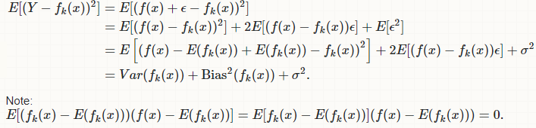
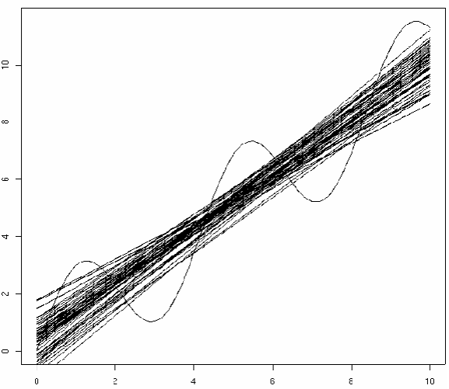
Bias Variance Decomposition
For each data point x, we have the observed value y and several predictions y suppose K (number of lines)
Compute the average prediction h.
Estimate bias as ( h – y)
Estimate variance as
Σ k (y k – h ) 2/(K – 1)
Assume noise is 0

